Slide 1

Introduction to basic AWK Part II
Hoàng Kim
Trương Anh Tú
16.02.2025
https://i.ebayimg.com/images/g/8w4AAOSwTQFdRLIJ/s-l1600.jpg

Slide 2
Table of contents
01
02
05
03
06
04
07
Review basic Awk part I
Awk Simple If statement
Awk For Loop
Awk If-Else statement
Practice examples
Awk While Loop
Homework

Slide 3
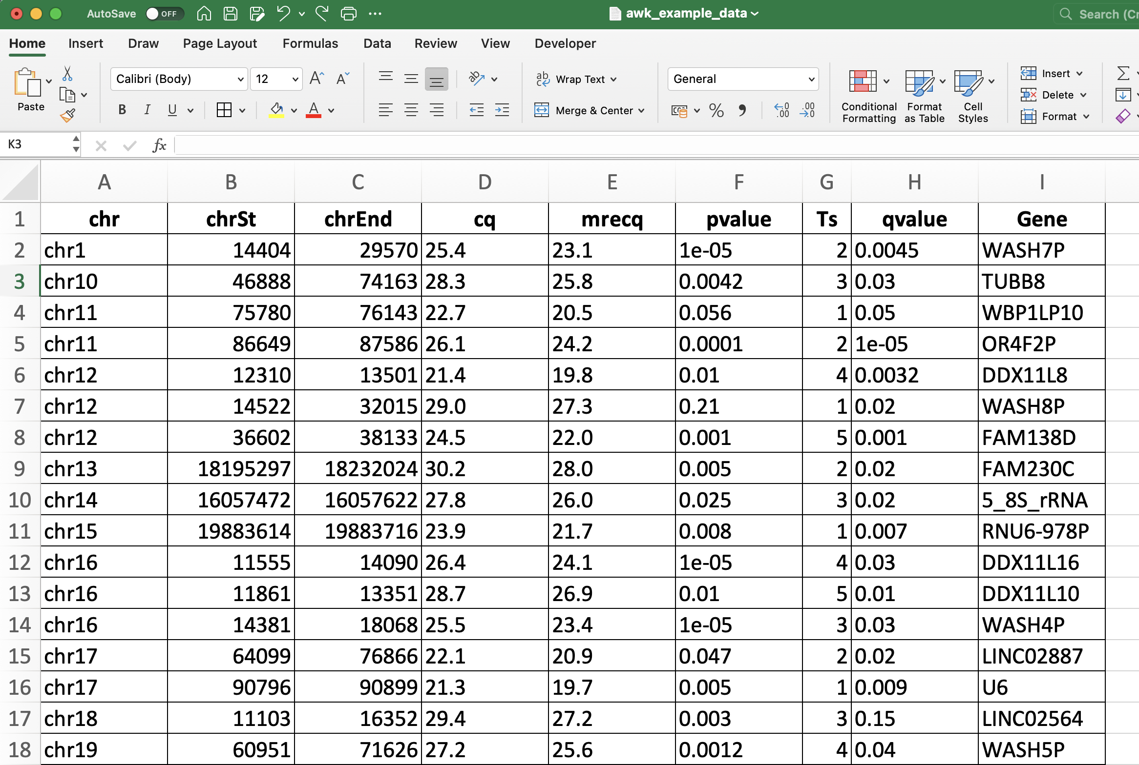
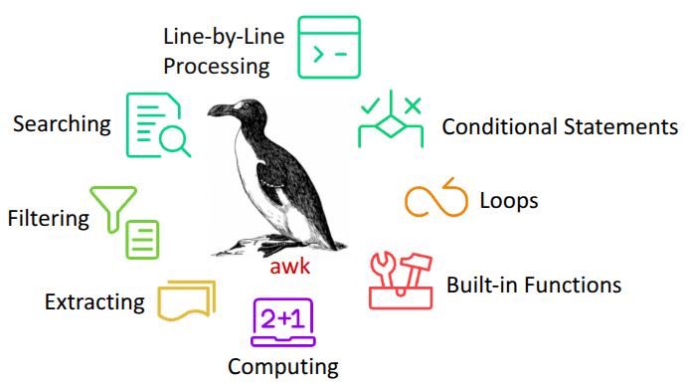
Review basic awk part I
Field
The awk command is a Linux tool and programming language that allows users to process text files. It is especially helpful when the lines in a text files are in a record format, i.e, when each line (record) contains multiple fields separated by a delimiter. You can also write programming logic using awk even when there are no input files that needs to be processed.
Syntax:
awk [options] 'selection _criteria {action }' input-file > output-file
Record
$0 = entire record
$1
$2
$NF = last field

Slide 4
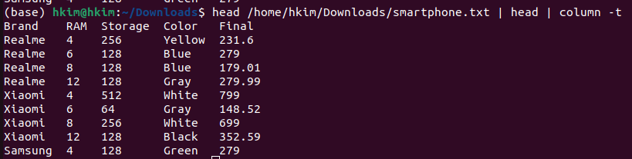
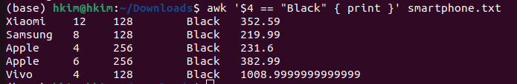
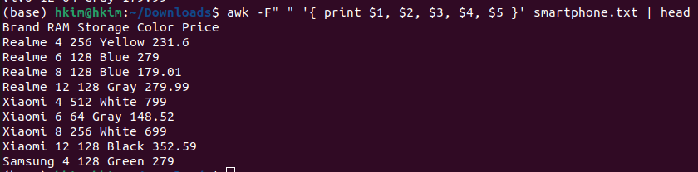
Review basic awk part I

Slide 5
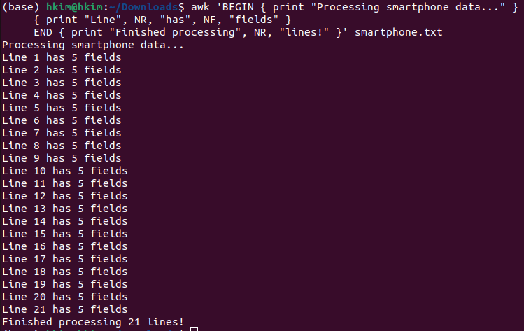
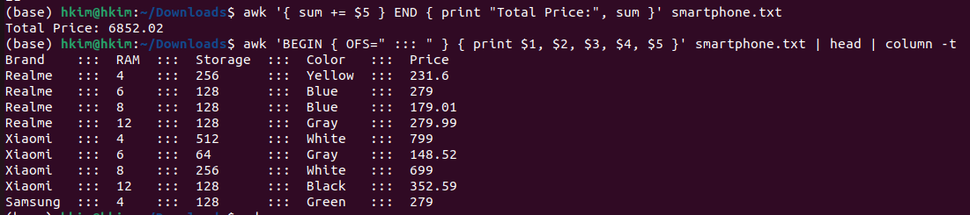
Review basic awk part I
BEGIN and END Block
Syntax:
awk ‘BEGIN {} {action} END {}’ input file
BEGIN {} executes commands before processing any input
END {} executes commands after all input is processed
Awk cheatsheet

Slide 6

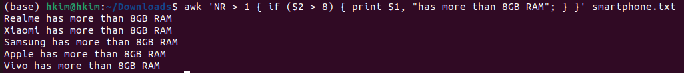
Awk Simple If statement
The simple if statement tests a condition, and if the condition returns true, performs the corresponding action(s).
Syntax: awk '{if (condition) {statement} }' [input_file]

Slide 7
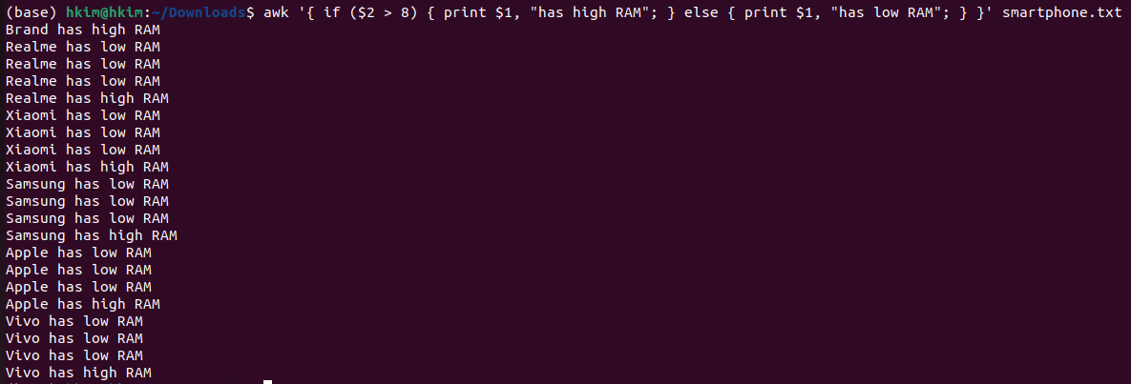
Awk If-Else statement
In the awk "If Else" statement you can also provide list of actions to perform if the condition is false. In the following syntax, if the condition is true statement 1 will be performed, if the condition is false statement 2 will be performed.
Syntax: if (condition) { statements } else { statements }

Slide 8
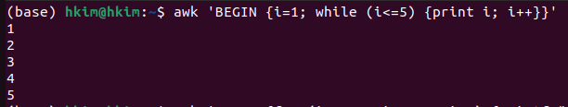
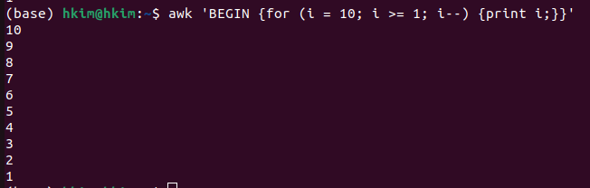
Awk While Loop
Awk For Loop
Awk while looping statements are used to perform a set of actions again and again in succession. Awk keeps executing a statement as long as the loop condition is true.

Slide 9
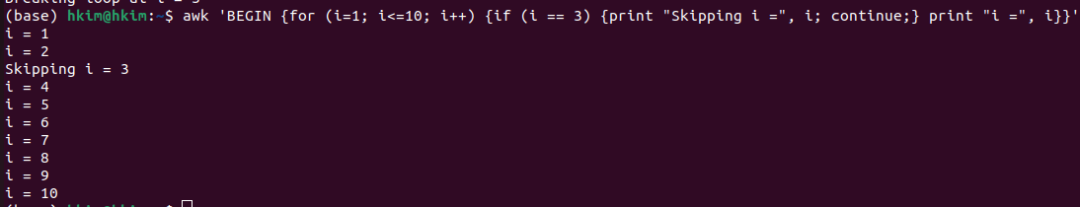
Break statement
Continue statement

Slide 10

Practice
Homework
Practice_basic AWK part II
Homework basic AWK part II

Slide 11
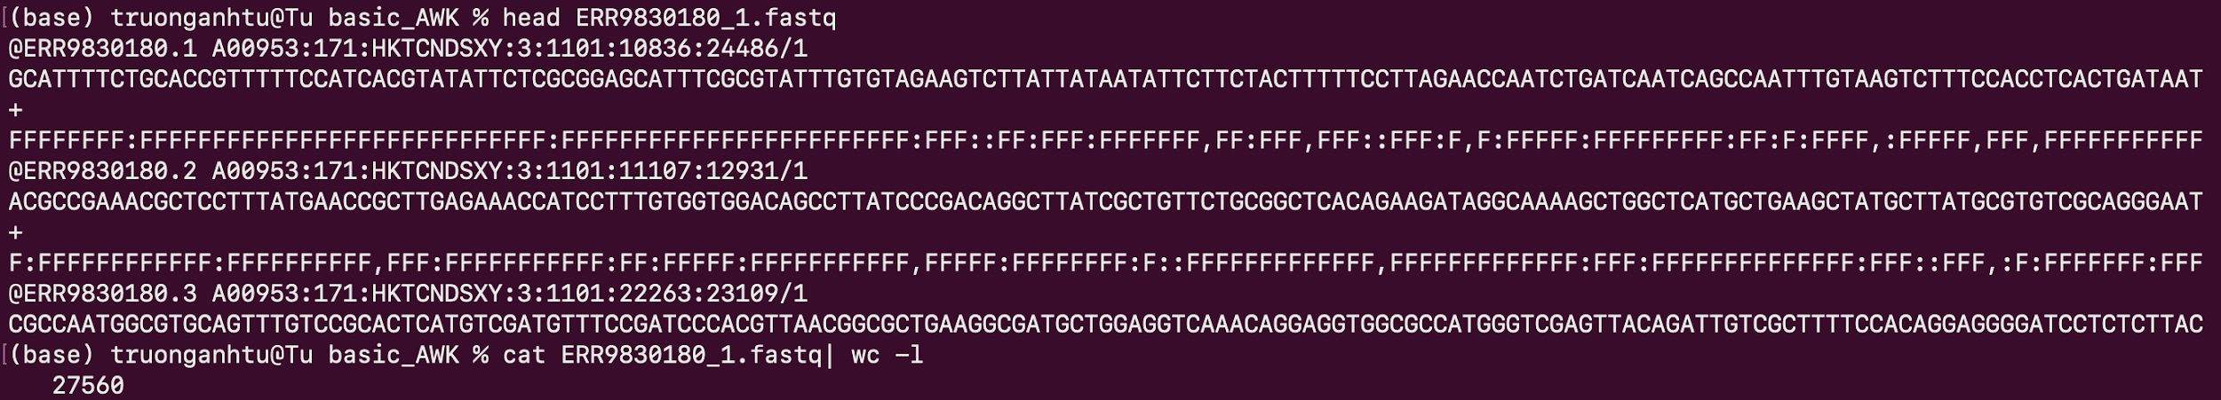


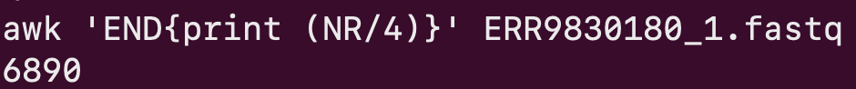
Practice examples
FASTQ file
1
2
3
4
5
6
7
8
9
10
?
2
6
10

Slide 12
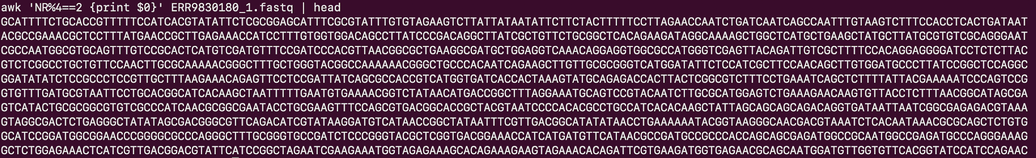
Practice examples
FASTQ file
1
2
3
4
5
6
7
8
9
10
NR%4==2
2
6
10
…
length

Slide 13
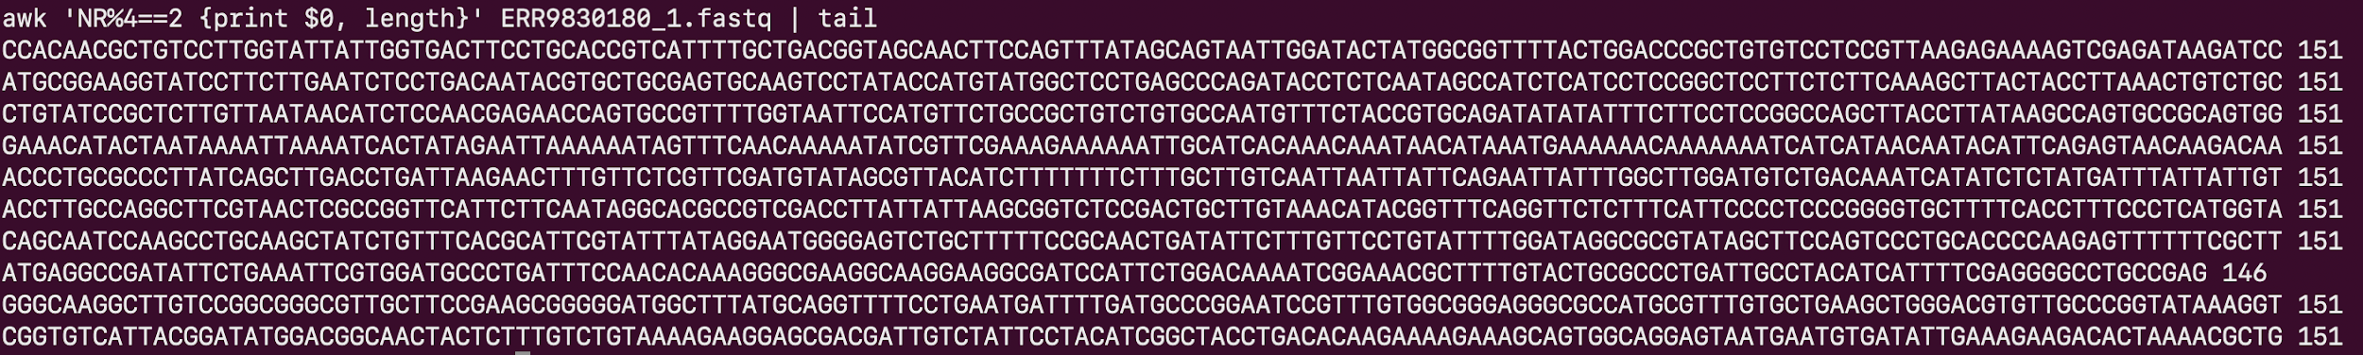
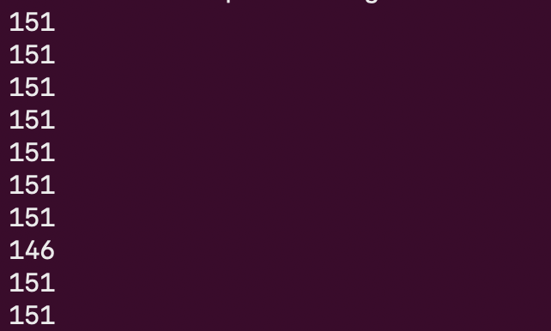
Practice examples
FASTQ file
1
2
3
4
5
6
7
8
9
10
length
How to calculate the average length of sequences in a FASTQ file?

Slide 14
Practice examples
FASTQ file
1
2
3
4
5
6
7
8
9
10
Calculating the average length of sequences in a FASTQ file

Slide 15
Practice examples
FASTQ file
1
2
3
4
5
6
7
8
9
10
Calculating the average length of sequences in a FASTQ file

Slide 16
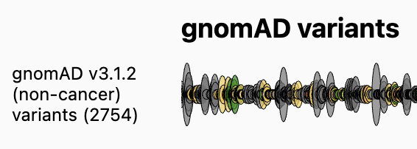
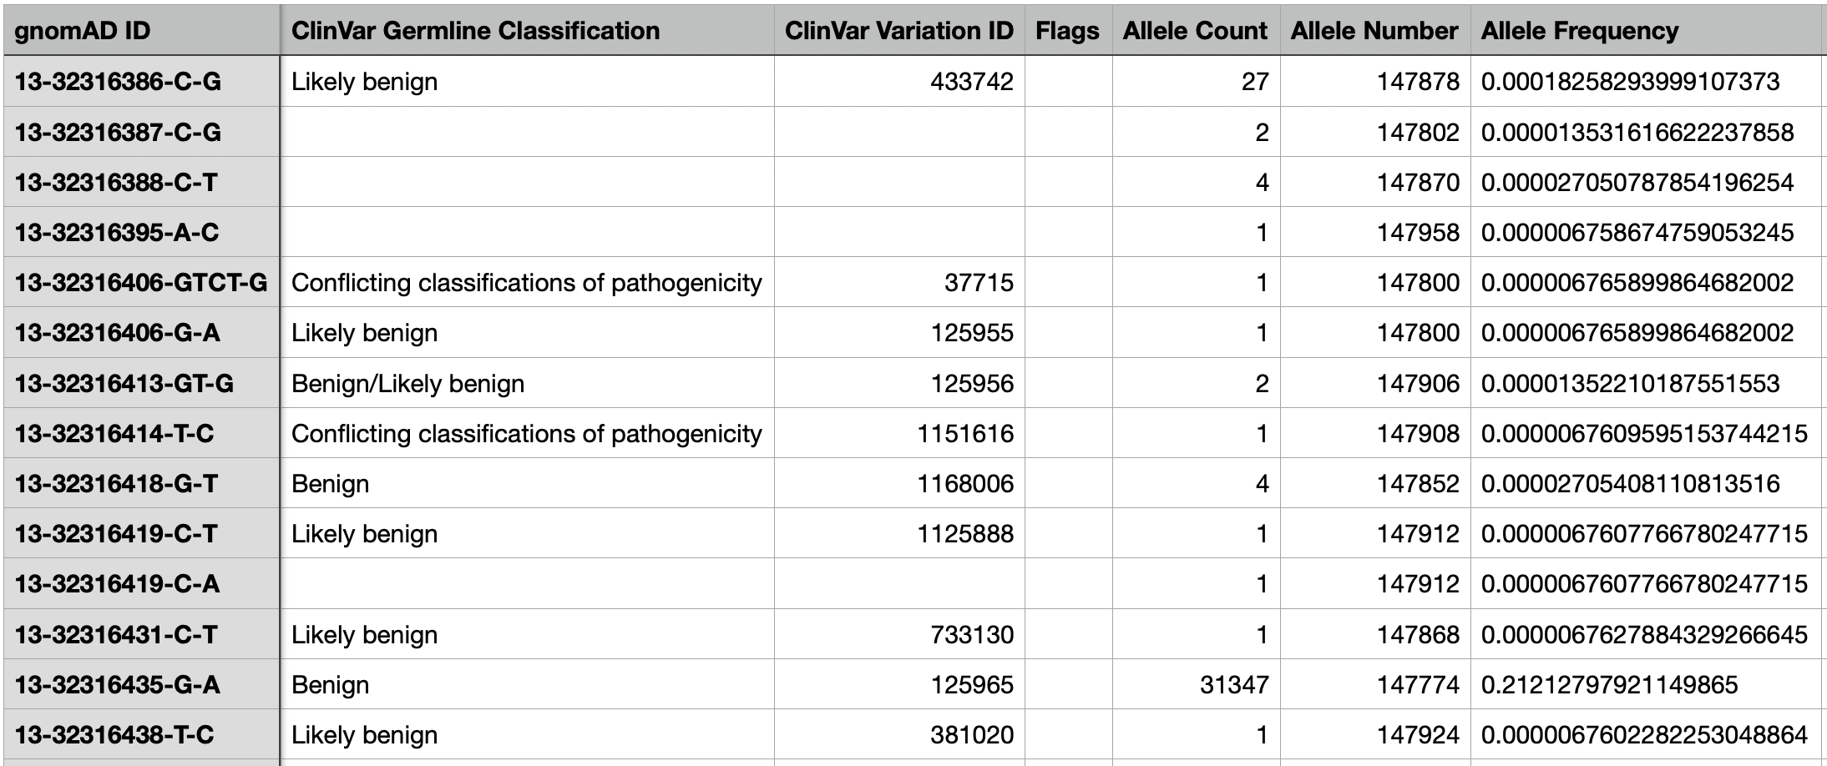
Practice examples
$?
How to extract variants with an Allele Frequency greater than 5%?
https://gnomad.broadinstitute.org/gene/ENSG00000139618?dataset=gnomad_r3_non_cancer

Slide 17
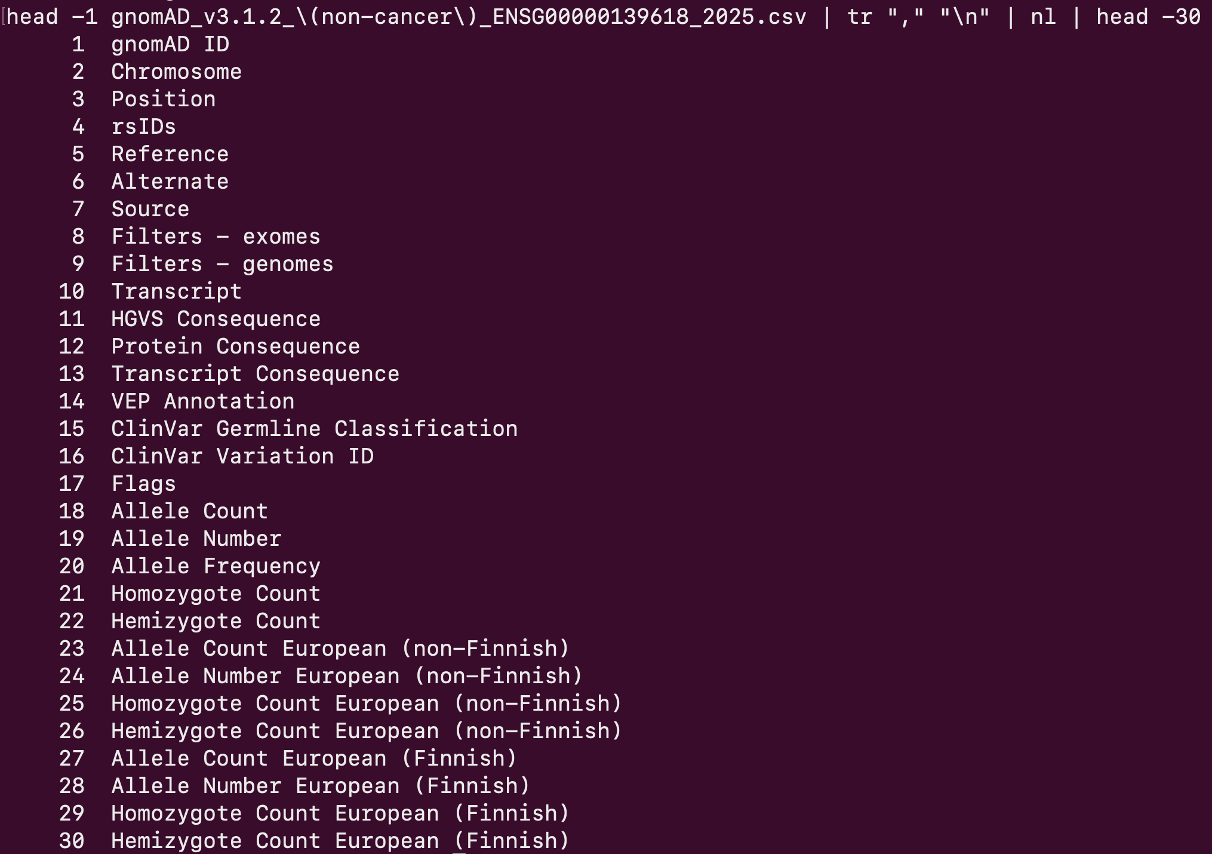
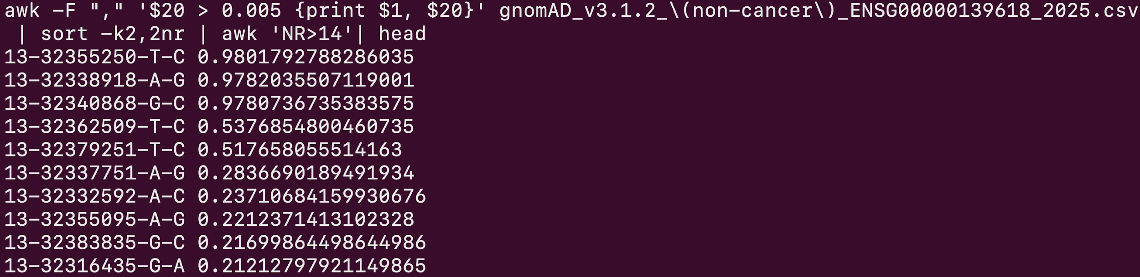
Practice examples
$
https://gnomad.broadinstitute.org/gene/ENSG00000139618?dataset=gnomad_r3_non_cancer

Slide 18
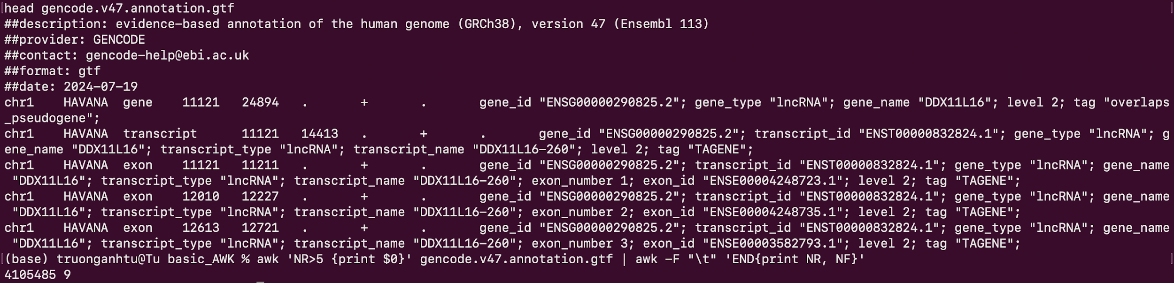
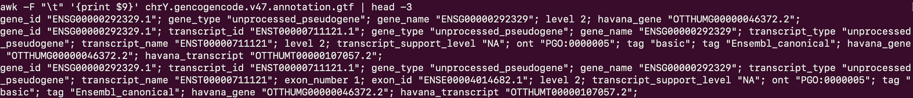
Practice examples
GTF file
$9
https://www.gencodegenes.org/human/

Slide 19
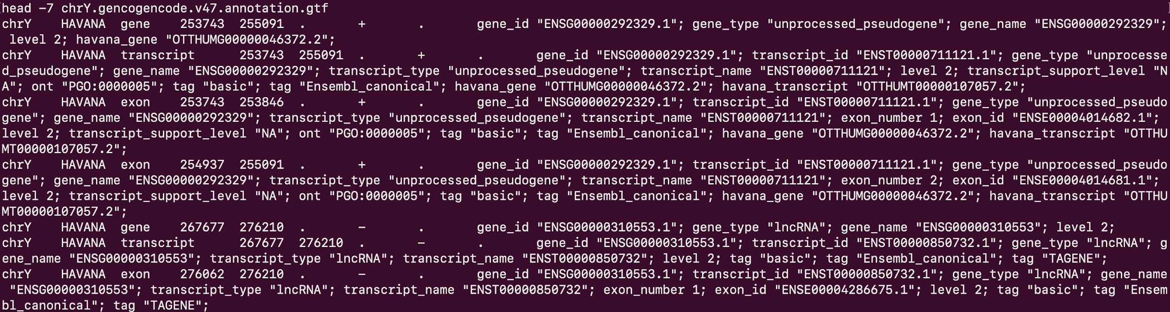
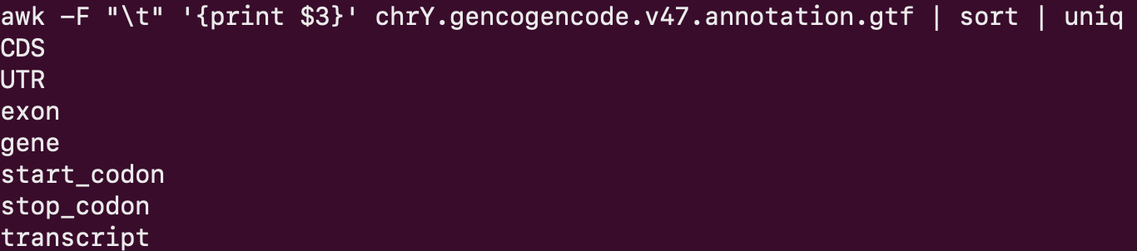
Practice examples
GTF file
How many occurrences of each feature are there in the GTF file?
https://drive.google.com/file/d/1ELKdmns_2M_UxQMu8nlipsflUK7PEghc/view?usp=sharing
https://www.gencodegenes.org/human/

Slide 20
Practice examples
GTF file
Which exon is the longest?
Which gene is the longest?
https://drive.google.com/file/d/1ELKdmns_2M_UxQMu8nlipsflUK7PEghc/view?usp=sharing
https://www.gencodegenes.org/human/

Slide 21
Practice examples
GTF file
$4
$5
Which gene is the longest?
https://drive.google.com/file/d/1ELKdmns_2M_UxQMu8nlipsflUK7PEghc/view?usp=sharing
https://www.gencodegenes.org/human/

Slide 22
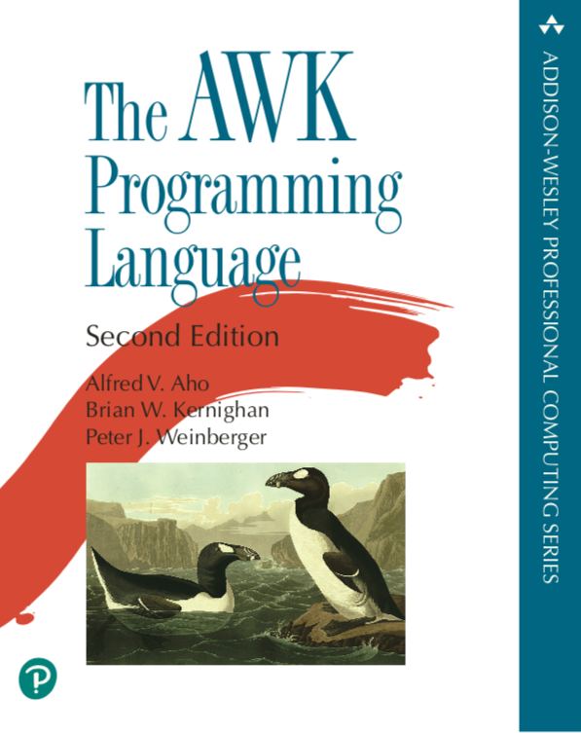

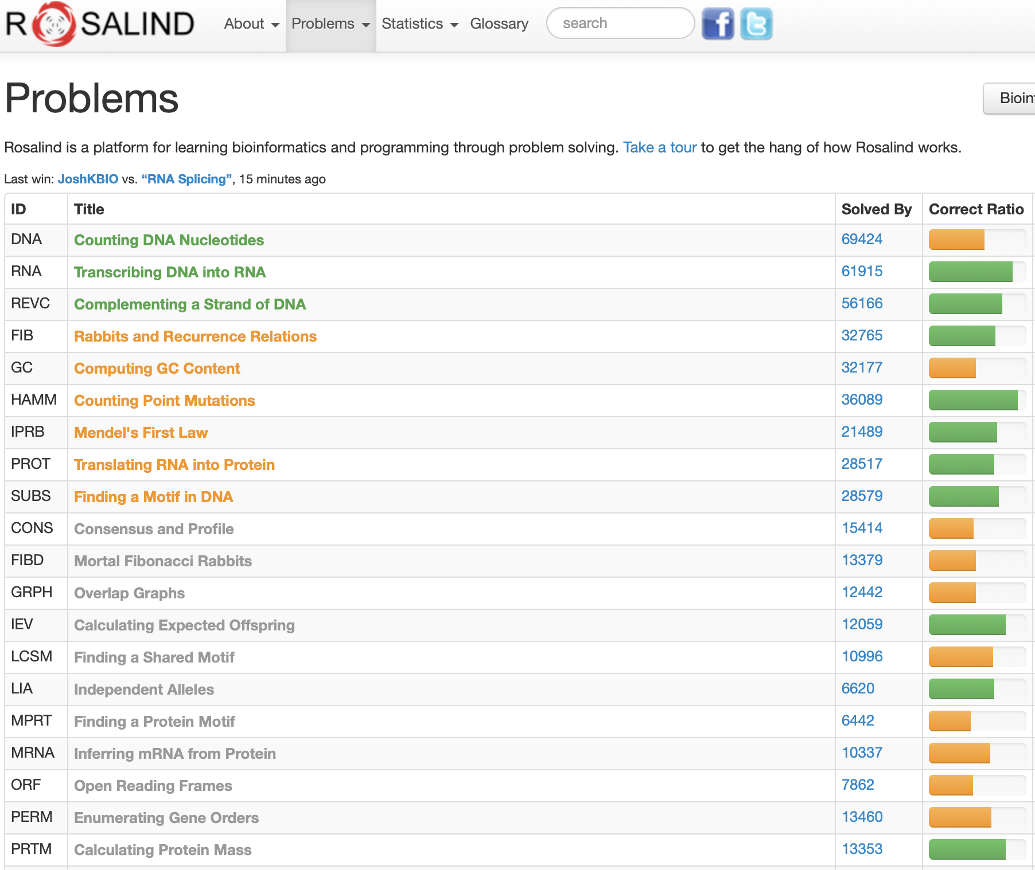
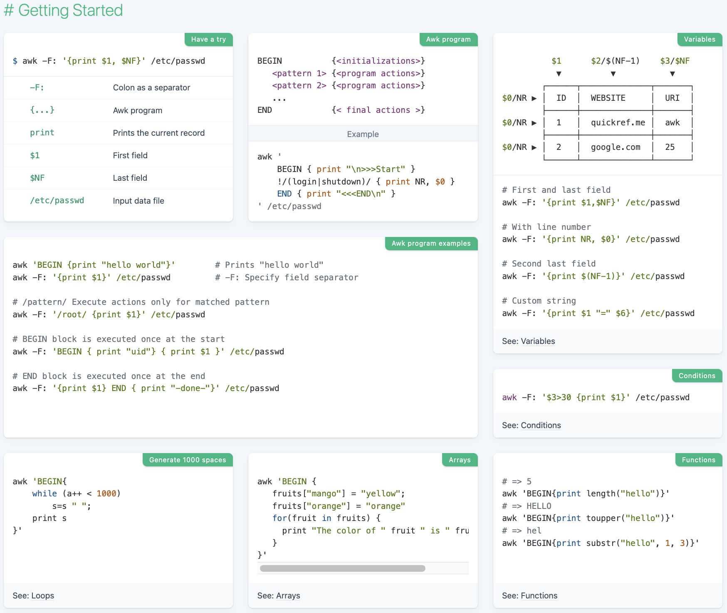

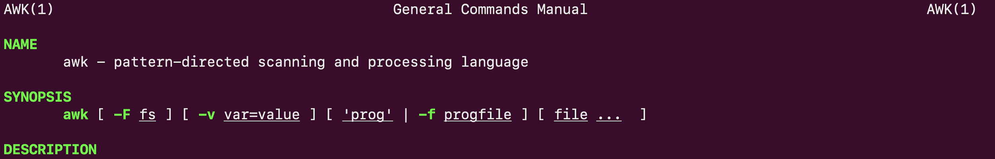
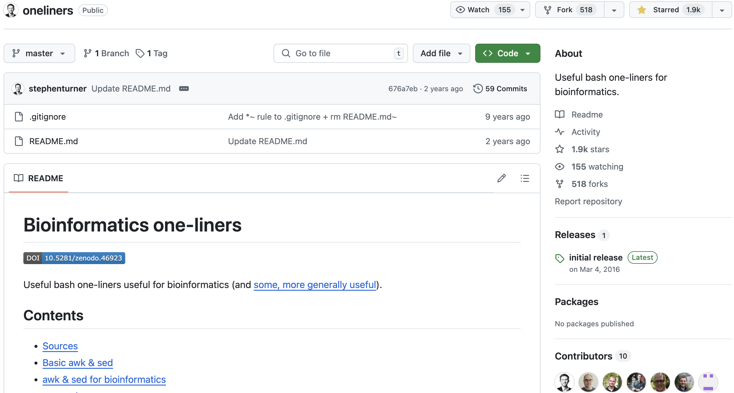
References
AWK cheat sheet
Basic learning awk
Practice Link
GitHub Issues
https://quickref.me/awk.html
https://www.amazon.com/dp/0138269726
https://github.com/stephenturner/oneliners

Slide 23
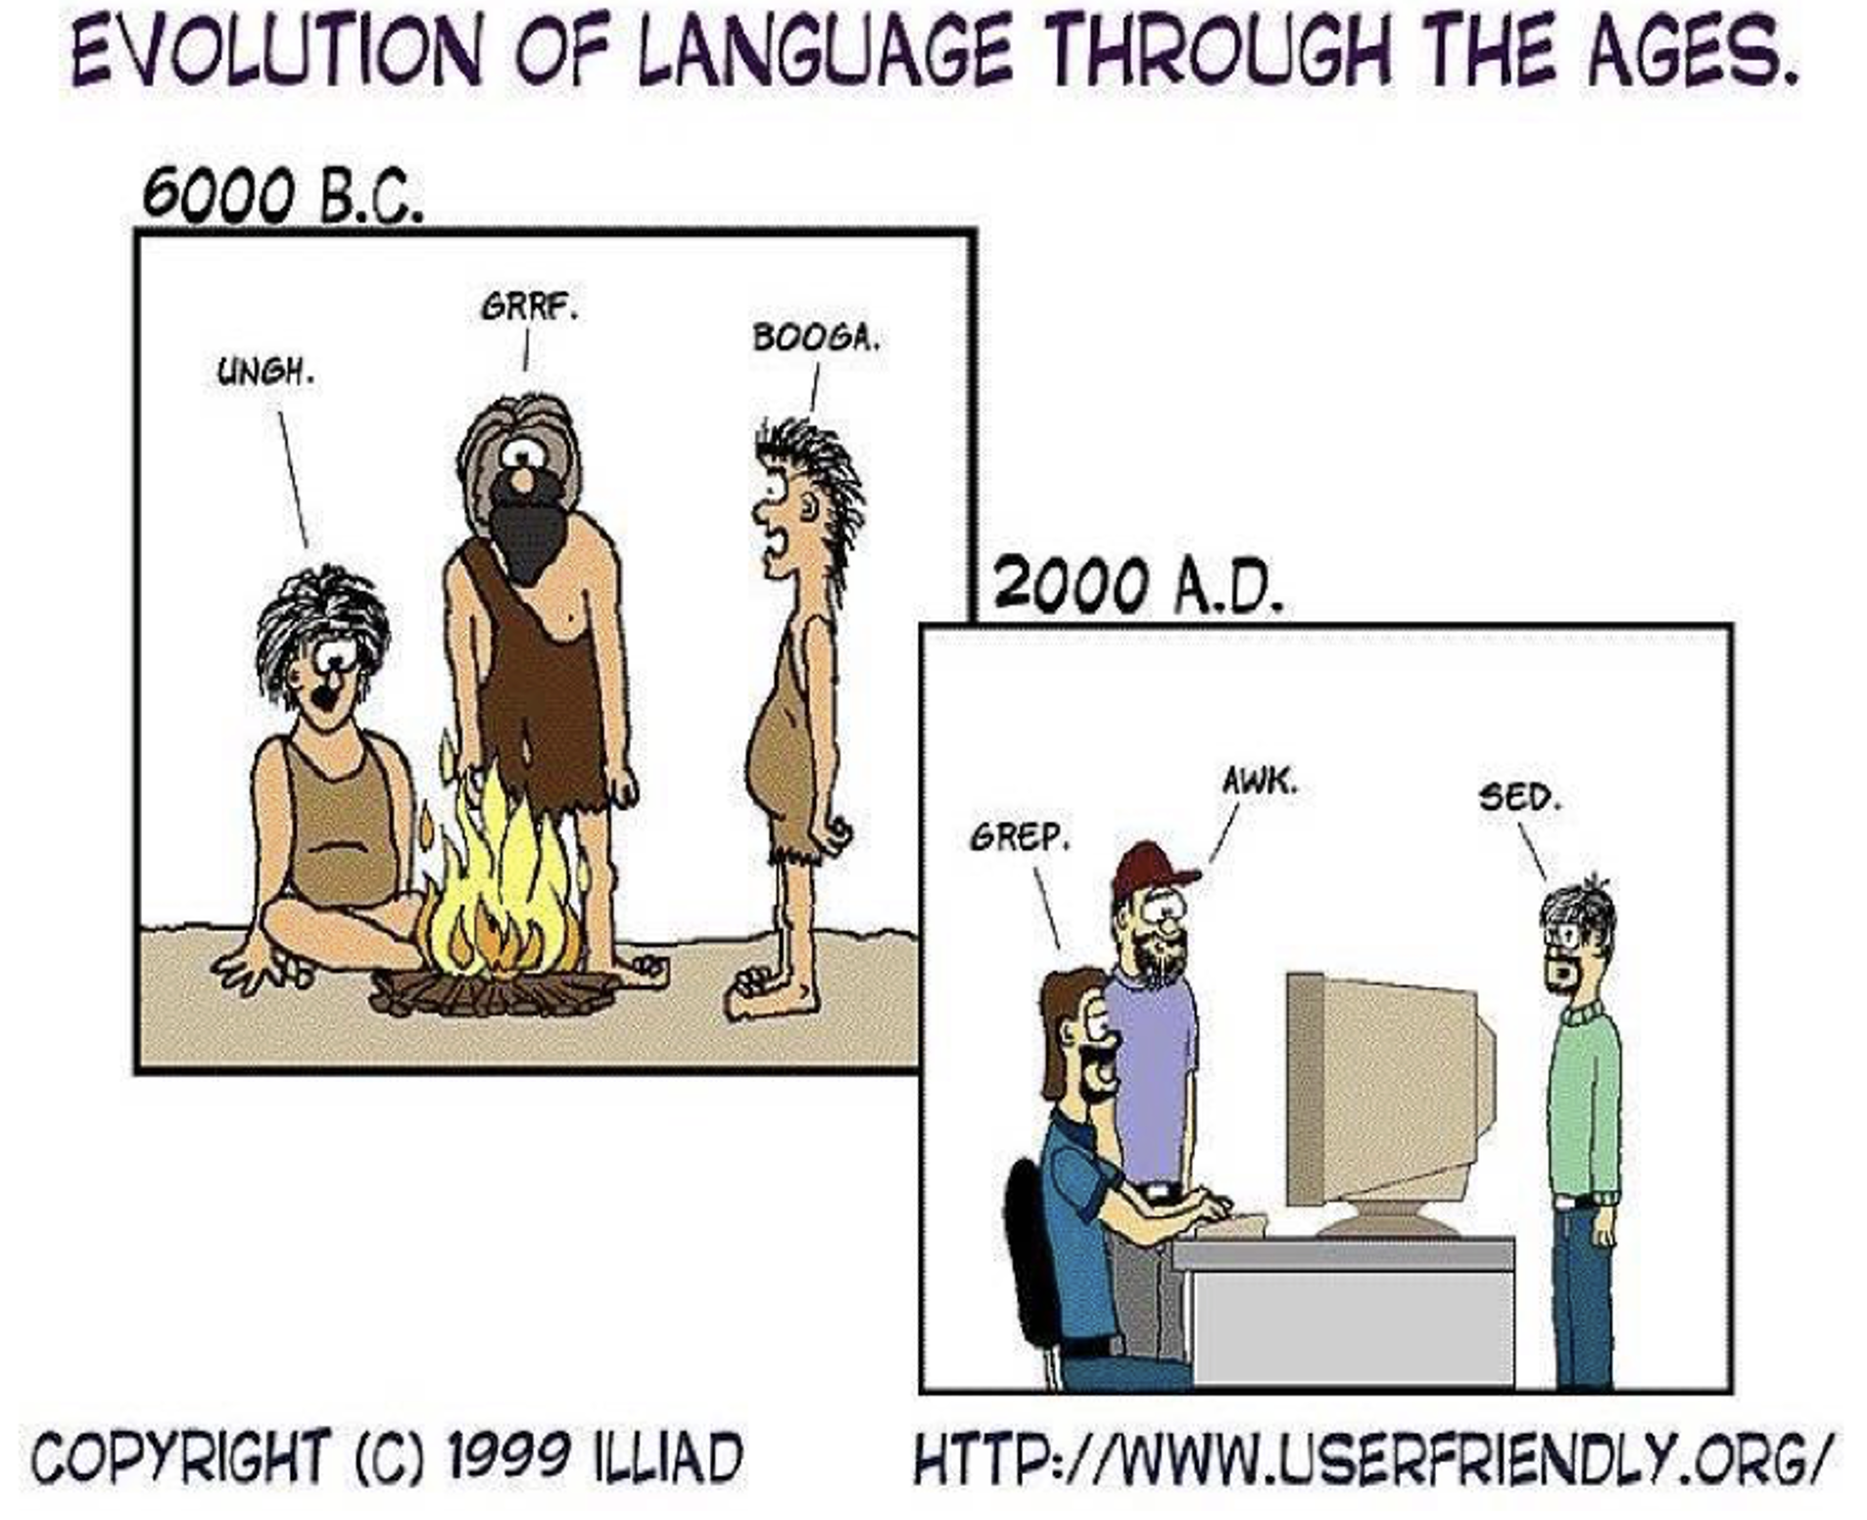

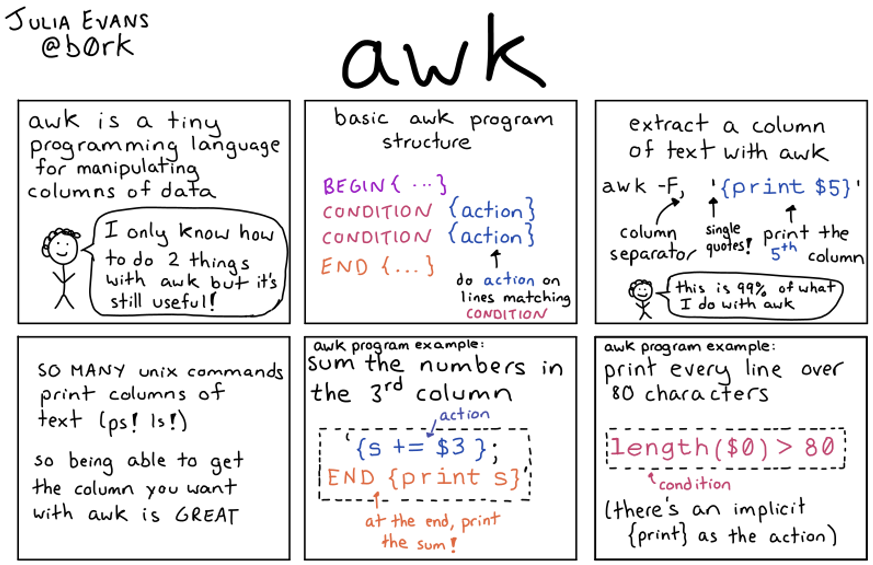
https://www.awk.dev/
https://wizardzines.com/comics/awk/

Slide 24

Thank for your attention!
awk option ‘selection_criteria {action}’ input file
https://i.ebayimg.com/images/g/8w4AAOSwTQFdRLIJ/s-l1600.jpg

